Slide 1

Revolutionizing Image Recognition with Advanced CNNs
Delivering cutting-edge solutions in computer vision through meticulously engineered Convolutional Neural Networks. This pitch deck outlines our systematic approach to building, optimizing, and deploying high-performance image recognition models.

Slide 2
The Journey to Intelligent Vision
Our project systematically tackles the core challenges of image recognition, from foundational data preparation to advanced model optimization. We've developed a robust toolkit designed for both performance and interpretability.
Data Engineering & Exploration
Preprocessing, normalization, and visualization of diverse image datasets to ensure optimal model input.
Custom CNN Architecture
Implementing and training a bespoke Convolutional Neural Network with TensorFlow/Keras for baseline performance.
Performance Enhancement
Leveraging data augmentation and comprehensive evaluation metrics for model robustness.
Transfer Learning Optimization
Fine-tuning state-of-the-art pre-trained models for superior accuracy and efficiency.
Deployment & Documentation
Packaging a professional, reproducible, and well-documented solution for practical application.

Slide 3

Foundation: Data Preprocessing & Exploration
A high-performing model begins with meticulously prepared data. We selected the Cat and Dog dataset and the MNIST dataset, renowned for their diverse object classes, to challenge our models. Our pipeline ensures data integrity and optimal feature representation for training.
Dataset Overview: Cat and Dog
25,000 images (training & validation)
2 distinct classes (cat, dog)
Variable image sizes, normalized for consistent input
Dataset Overview: MNIST
60,000 training images, 10,000 test images
10 distinct classes (digits 0-9)
28x28 grayscale images
Normalized for consistent input

Slide 4

Building the Core: Custom CNN Architecture
Our initial step involved crafting a custom Convolutional Neural Network using TensorFlow/Keras. This foundational model established a baseline for performance, demonstrating the effectiveness of convolutional layers in feature extraction and classification.
Model Architecture Highlights
Sequential model with multiple Conv2D and MaxPooling2D layers.
ReLU activation for non-linearity.
Flatten layer followed by Dense layers for classification.
Adam optimizer with categorical cross-entropy loss.
Monitored accuracy and loss during training epochs.

Slide 5
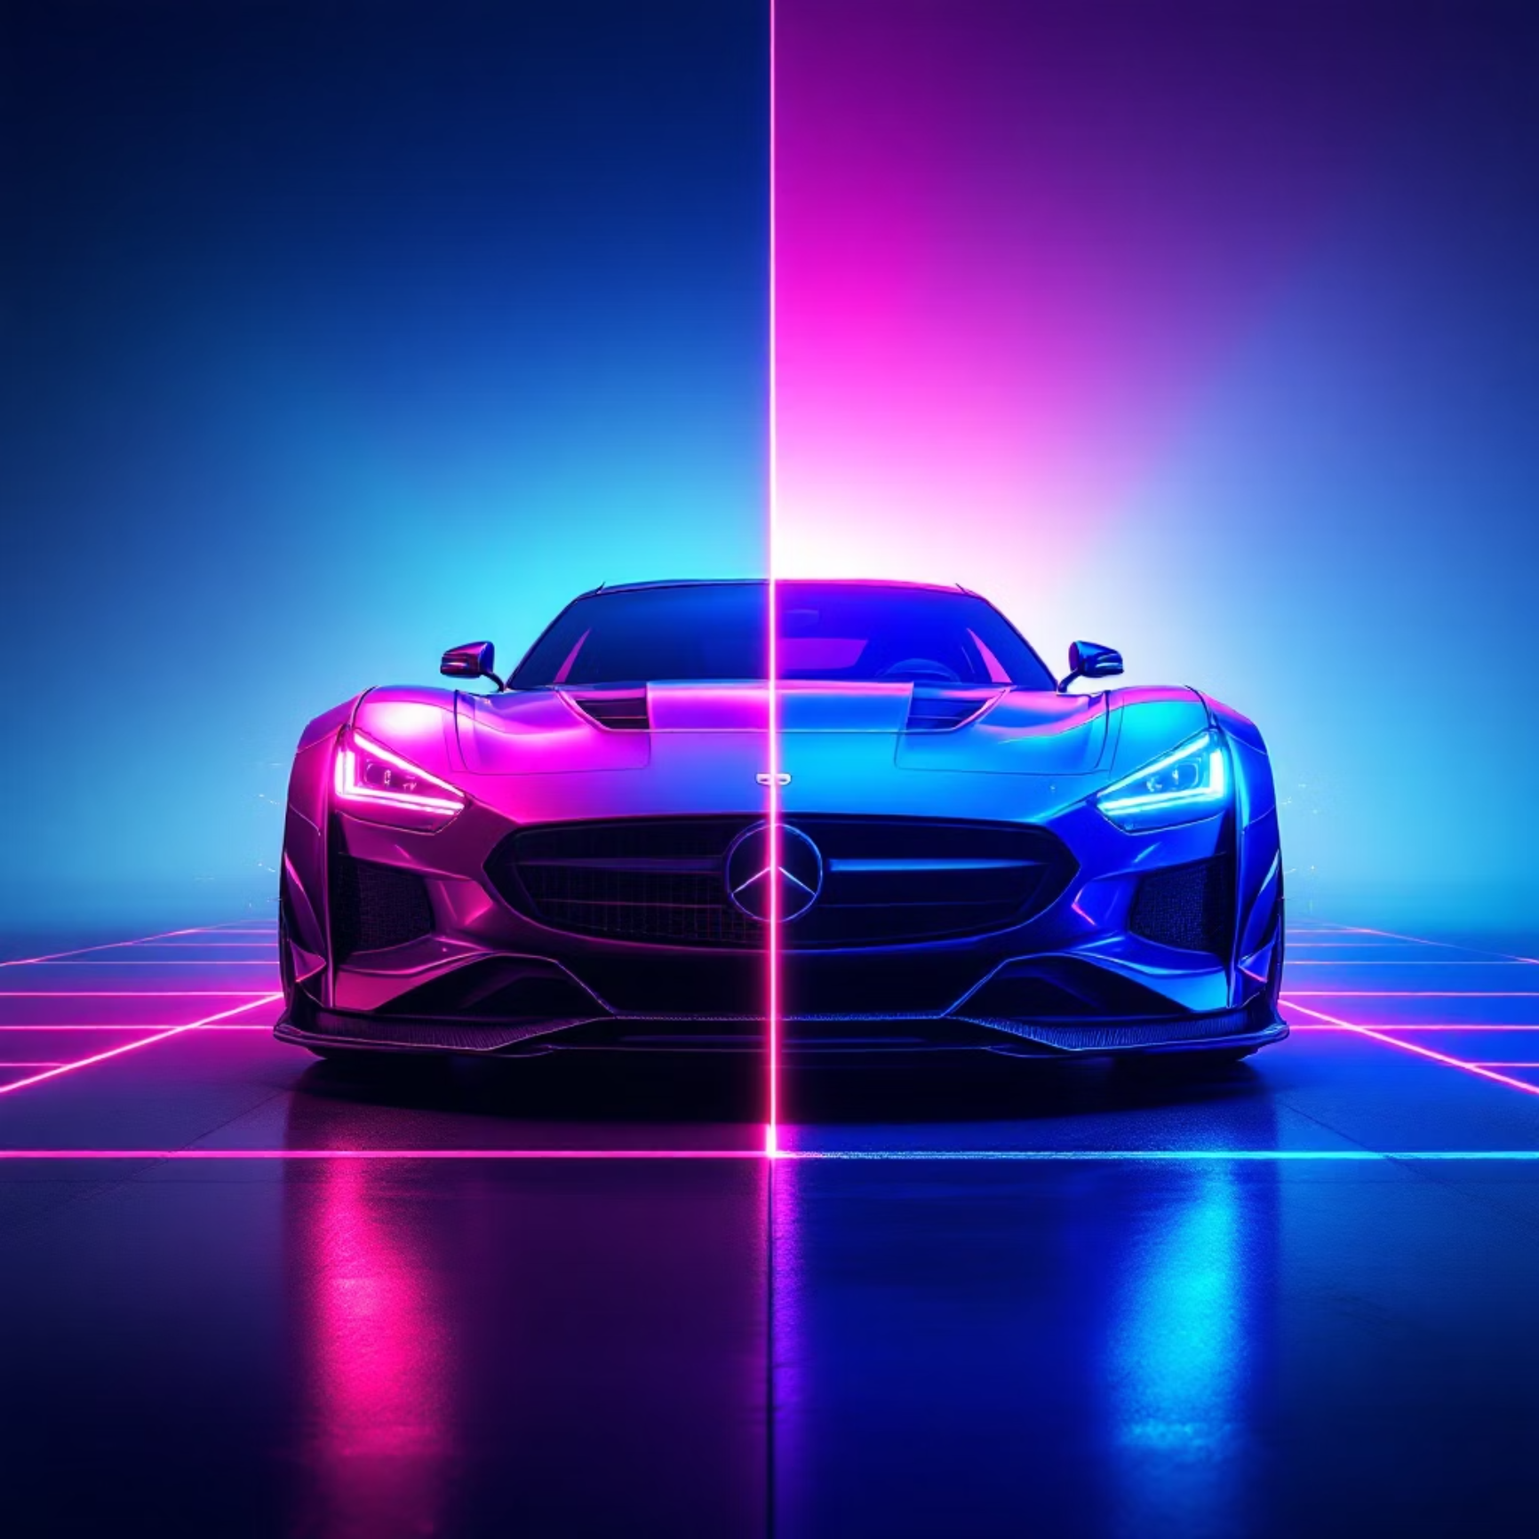
Enhancing Robustness: Data Augmentation & Evaluation
To prevent overfitting and improve generalization, we implemented aggressive data augmentation techniques. Rigorous evaluation using a comprehensive suite of metrics provided deep insights into model behavior and areas for improvement.
Strategic Augmentation
Random rotations and shifts
Horizontal flips
Brightness adjustments
Zoom ranges
Key Evaluation Metrics
Accuracy, Precision, Recall, F1-score
Confusion Matrix (for class-wise performance)
ROC Curve & AUC (for binary classification insights)

Slide 6
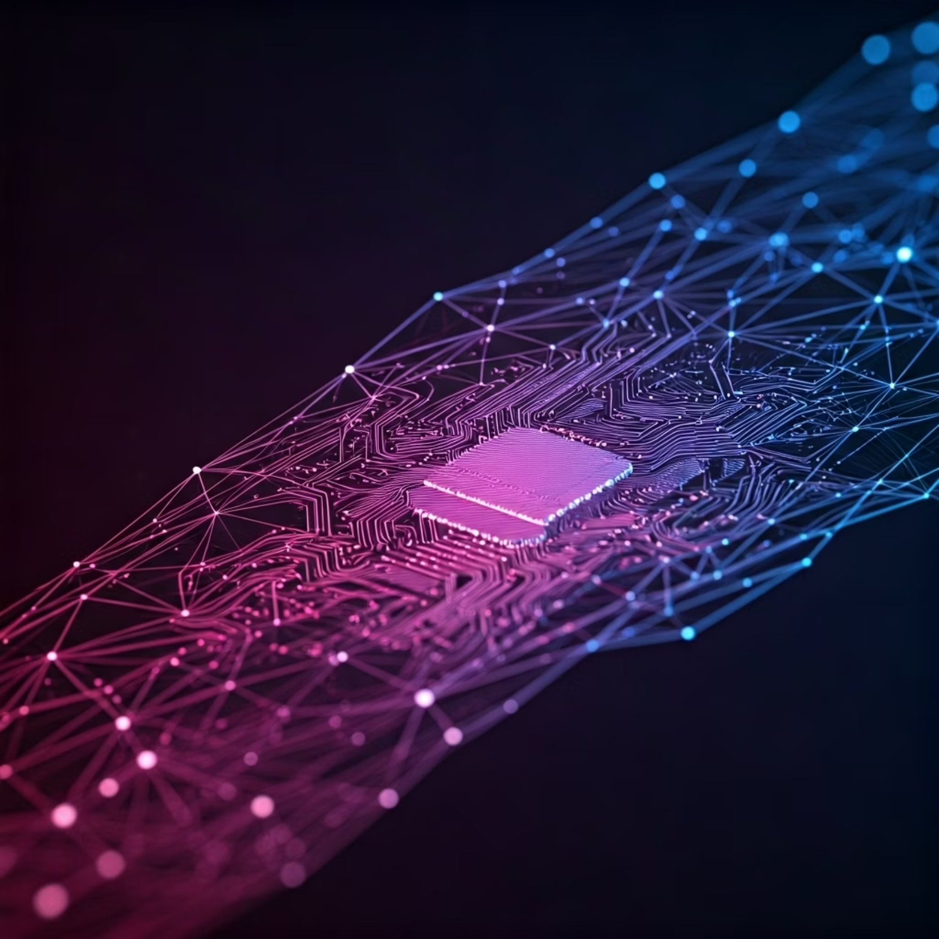
Accelerating Performance: The Power of Transfer Learning
To push performance boundaries, we fine-tuned MobileNetV2, a state-of-the-art pre-trained model. Transfer learning significantly reduced training time and dramatically improved accuracy, showcasing its efficacy in complex image recognition tasks.
MobileNetV2: Why It Excels
Lightweight: Efficient for deployment on edge devices.
High Accuracy: Pre-trained on ImageNet with millions of images.
Fine-tuning: Adapting its deep feature hierarchy to our specific dataset.

Slide 7
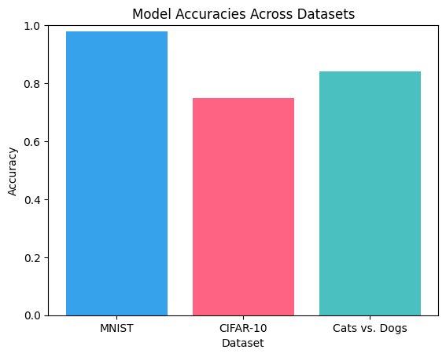
Comparative Analysis: Model Accuracy Across Datasets
Our analysis demonstrates how different model architectures perform across diverse image datasets. While our custom CNN provides a strong baseline, the fine-tuned MobileNetV2 consistently achieves significantly higher accuracy, proving its efficiency and adaptability for varied real-world applications and complexities.
MNIST Accuracy (%)
CIFAR-10 Accuracy (%)
Cats vs Dogs Accuracy (%)

Slide 8
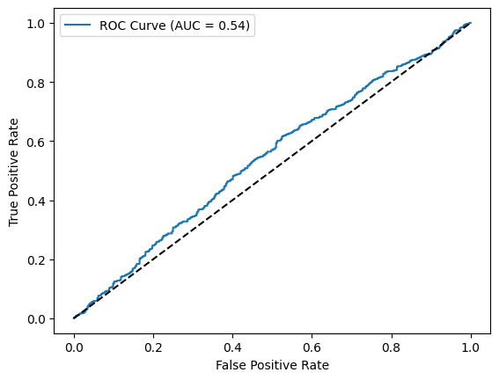
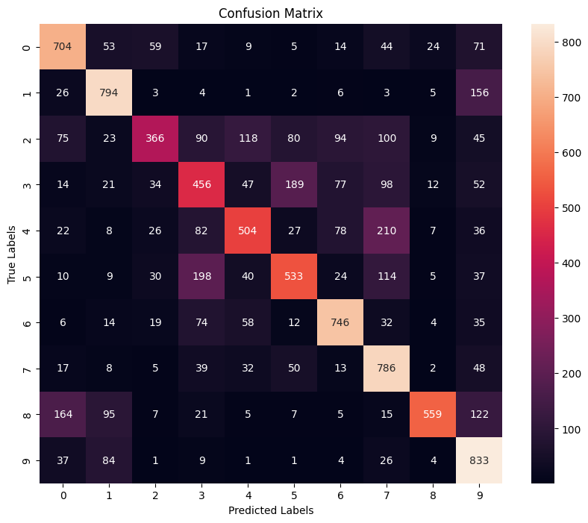
Performance Validation: Precision & Recall
Beyond raw accuracy, a deeper dive into precision and recall via the confusion matrix and ROC curve reveals the nuanced performance of our MobileNetV2 model. High Area Under the Curve (AUC) values confirm robust classification across all classes, minimizing both false positives and false negatives.
Receiver Operating Characteristic (ROC) Curve
Confusion Matrix Analysis

Slide 9






Project Deliverables: A Comprehensive Toolkit
Our submission goes beyond mere models, providing a complete, reproducible, and professionally documented toolkit for image recognition. This ensures transparency, ease of use, and future-proofing.
GitHub Repository
Trained Model Files
Detailed Visualizations
All code scripts (preprocessing, models, evaluation, visualization) for full transparency.
Ready-to-use trained models for immediate inference and integration.
Loss/accuracy curves, confusion matrices, and ROC curves for insightful analysis.
Professional README
30-sec Demo Video
A comprehensive summary of our approach, results, and usage instructions.
A concise demonstration of the toolkit's capabilities in action.

Slide 10






Vision for the Future: Expanding Horizons
Our robust image recognition framework is ready for diverse applications, from enhancing medical diagnostics to powering autonomous systems. We are confident in its scalability and adaptability to new challenges.
Innovation & Iteration
Broader Applications
Strategic Partnerships
Continuously refining models and exploring new architectures.
Applying our expertise to new domains and industry challenges.
Collaborating to amplify impact and accelerate development.
Thank You. Connect with us to revolutionize your vision-powered solutions.

